Slide 1
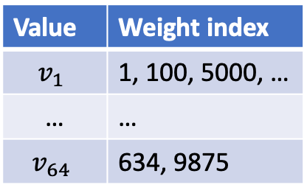
Quick Overview of our Hardware Acceleration Effort
What does it mean by “efficiency”?
Computation: to run inference faster
GPU Memory: to store the model instances
Bandwidth: to transfer data into GPU
Value | Weight index
$$v_{1}$$ | 1, 100, 5000, …
… | …
$$v_{64}$$ | 634, 9875
Weights are mapped into
1 of 64 values
GPU Memory
(Weights)
System Memory
(Data)
GPU Computation Core

Slide 2
Quick Overview of our Hardware Acceleration Effort
What are the constraints for LAM/LLM?
Via some rough calculations, LAM/LLM seems to be constrained mainly by GPU memory
(With CPU decoding, computation is the main constraint .)
ChatGPT 175B params * 16bit = 350GB, text only 1B params * 16bit = 2GB
 | Model Num Params (B) | Model Memory (GB) | GPU Memory (GB) | Speed (teraFLOPS) | GPU bandwidth (GBps) | Number of Max Supportable Models | Min Latency due to Computation | Min Latency due to Bandwidth
8x Nvidia A100 GPU | 175 | 350 | 8*80 | 8*312 | 2039 | 1 | < 0.1ms (175/(8*312)) | < 0.01ms (12288*96*96*2/(2039*10^9))
G5.24xlarge | 1 | 2 | 96 | 4*125 | 600 | 48 (~96/2) | RescoreBERT < 0.1ms (33*1/(4*125*10^3)) 1B Conformer - 3ms (50*33*1/(4*125*10^3)) for 50 frames - 48s if using G5 CPUs (33*50*1/96*2.8) | RescoreBERT < 0.01ms 1B Conformer - 3ms (33*50*4096*17*8*2)/(600*10^9)

Slide 3
Quick Overview of our Hardware Acceleration Effort
Technologies to improve each aspect
 | Applicable | Memory Reduction | Computation Reduction | Bandwidth Reduction
Quantization | All layers | 50% (16bit → 8bit) | 50% (16bit → 8bit) | 50% (16bit → 8bit)
Sparsification | All layers | 50% (50% sparse) | 50% (50% sparse) | -
Sub-8-bit compression | All layers | 50% (8bit → 4bit) | 50% (8bit → 4bit) | -
Arbitrator, turning layers on and off | All layers | - | 50% | -
Low rank approximation | Attention | No info | No info | -
Weight sharing | All layers | 50% (2 layers share 1) | - | -
Compression for LAM-LLM embedding interface | Embedding, interface | 75% (32bit → 8bit) | - | 75% (32bit → 8bit)

Slide 4
Quick Overview of our Hardware Acceleration Effort
Technologies to improve each aspect
Computation
Memory
Arbitrator
Quantization
Weight sharing
Sparsification
Low rank for Attention
Compression for LAM/LLM interface
Sub-8-bit compression

Slide 5
Quick Overview of our Hardware Acceleration Effort
What are the constraints for LAM/LLM?
Right now with our preliminary NemoRT implementation, we are constrained by computation more → the demand for quantization and sparsification
Quantization: 3-4x → reduce latency + increase throughput → reduce 3-4x fleet cost
But naïve post-training quant degrades model performance significantly
RescoreBERT
1B Conformer: even with FP16 we already saw significant degradation
 | Latency (ms)
Task | FP32 | FP16 | INT8
Context creation | 365,165 | 208,906 | 6,057
Inference | 14,162 | 7.987 | 4,456
 | Inference Output
CPU - FP32 | -8.2429 -13.112 -5.8216 -9.7047 -10.4250 -4.6697 -4.7104
GPU - INT8 quant | 0.0671 0.0671 0.0671 0.0671 0.0671 0.0671 0.0671

Slide 6
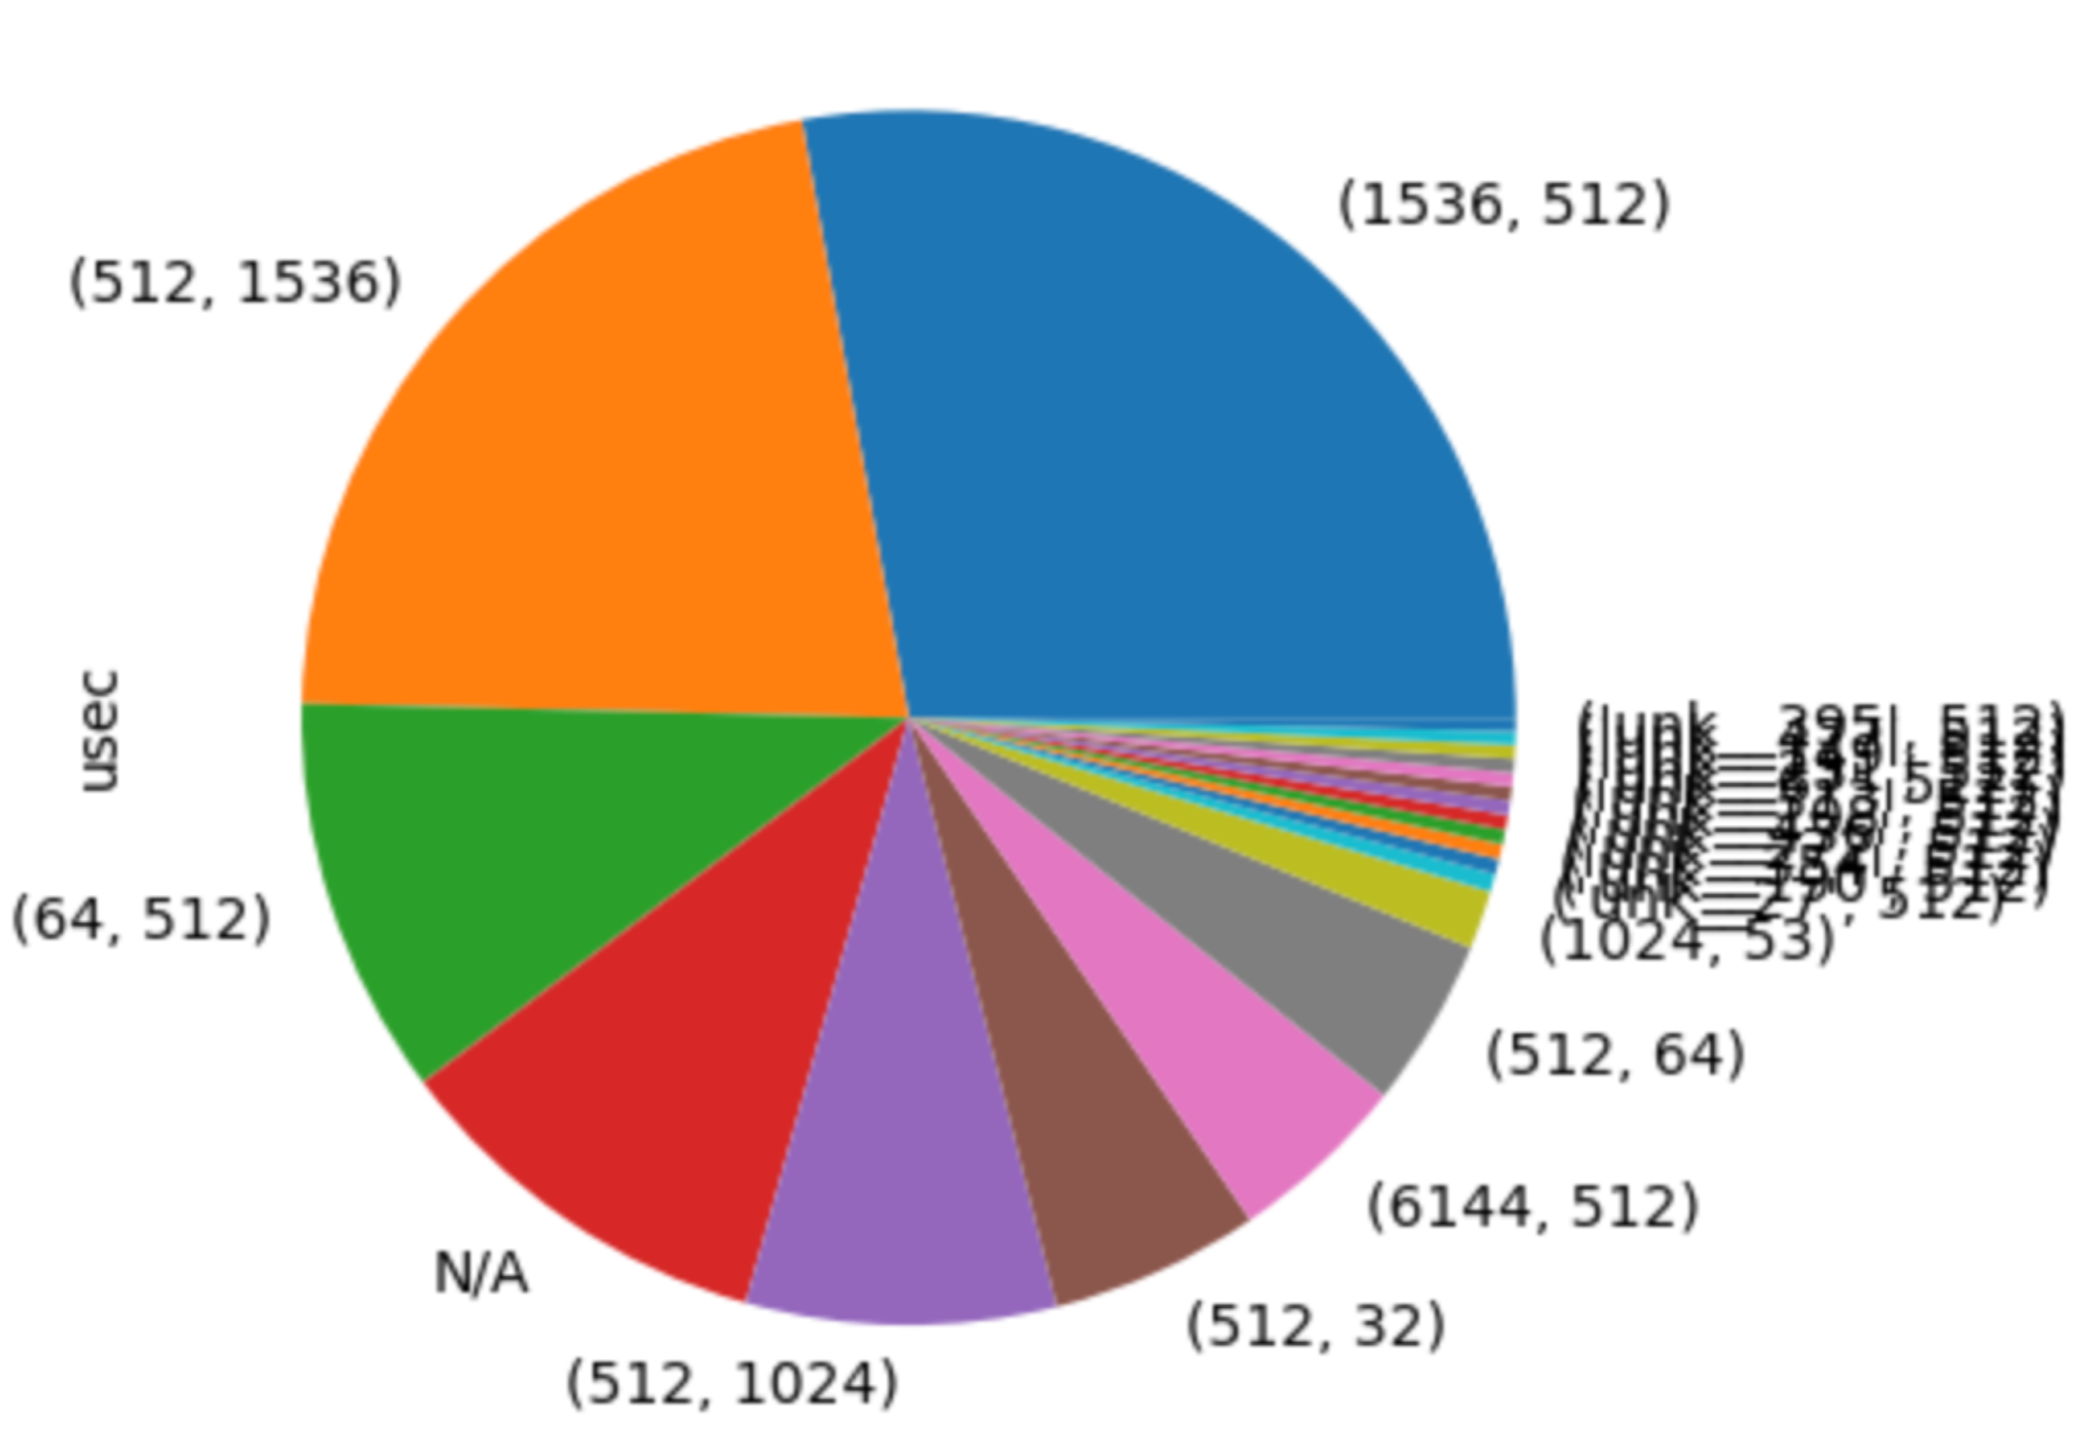
Quick Overview of our Hardware Acceleration Effort
Technologies to improve each aspect
Side note: Attention contributes only to 10% of the latency
Attention
Values
Attention
Keys/Queries

Slide 7
Quick Overview of our Hardware Acceleration Plan
Priority for 2023 – Technologies Applicable to All Layers
Quantization
Conformer – prod Conformer, next step 1B
RescoreBERT – kickstarted together with Denis, presented later by Martin/Yi
Sparsification
Conformer – NemoRT support needed
RescoreBERT – good results obtained, presented later
Embedding
8-bit quantization and sub-8-bit compression – on-hold as lacking HC

Slide 8
Quick Overview of our Hardware Acceleration Plan
Tentative Plan for 2024 – Technologies to Address Memory Constraint
Sub-8-bit weight
Weight sharing for LAM/RescoreBERT layers
Arbitrator turning layers on and off
Low-rank approximation of attention

Slide 9
LLM/RescoreBERT Quantization
Kickstart Meeting with YiGu, Denis, Shaun, Gautam, Chris, Bofeng, etc.
Bofeng preliminary results for naïve post-training quant
CPU FP32 output: [-8.2429 -13.1120 -5.8216 -9.7047 -10.4250 -4.6697 -4.7104]
GPU INT8 output: [0.06719 0.06719 0.067199 0.06719 0.06719 0.067199 0.067199]
Need Science assistance to test advanced post-training quant and quantization-aware finetuning
Timeline
Proof of Concept ready 08/15
Production ready: 09/01
Launch ready: 09/19
Science plan
Advanced post-training quantization: Smooth quant
Quantization-aware finetuning
Combination

Slide 10
Quick Overview of our Hardware Acceleration Plan
Priority for 2023 – Technologies Applicable to All Layers
Quantization
Conformer – prod Conformer, next step 1B
RescoreBERT – kickstarted together with Denis, presented later by Martin/Yi
Sparsification
Conformer – NemoRT support needed
RescoreBERT – good results obtained, presented later
Embedding
8-bit quantization and sub-8-bit compression – on-hold as lacking HC

Slide 11
Neural Efficiency via Software-Hardware Co-Design
Model optimization needs to be hardware specific.
Compression Type
Hardware Type
Model Type
Product Impact
(Sub-)8-bit quantization
NNA
(L)AM
Bluebottle, Crosstown
8-bit
quantization
CPU
Cloud ASR
2:4 sparsity
GPU
RescoreBERT
Cloud ASR (Let’s Chat)

Slide 12
Neural Efficiency via Software-Hardware Co-Design
Model optimization needs to be hardware specific.
Compression Type
Hardware Type
Model Type
Product Impact
(Sub-)8-bit quantization
NNA
(L)AM
Bluebottle, Crosstown
8-bit
quantization
CPU
Cloud ASR
2:4 sparsity
GPU
RescoreBERT
Cloud ASR (Let’s Chat)

Slide 13
8-bit Quantization for Cloud Conformer on CPU
Is QAT needed for cloud ASR?
Cloud ASR runtime also represents weights in 8-bit.
QAT won’t lead to latency reduction: the model runs in INT8 mode.
QAT for cloud Conformer is more of an accuracy-driver.
FP32
FP32
FP32
FP32
INT8
Conformer training in Phasa
Serialization in Phasa
IL in Phasa
EB in Phasa
Packaging
In DBS
FP8
~FP8
~FP8
~FP8
Conformer training in Phasa
Serialization in Phasa
IL in Phasa
EB in Phasa

Slide 14
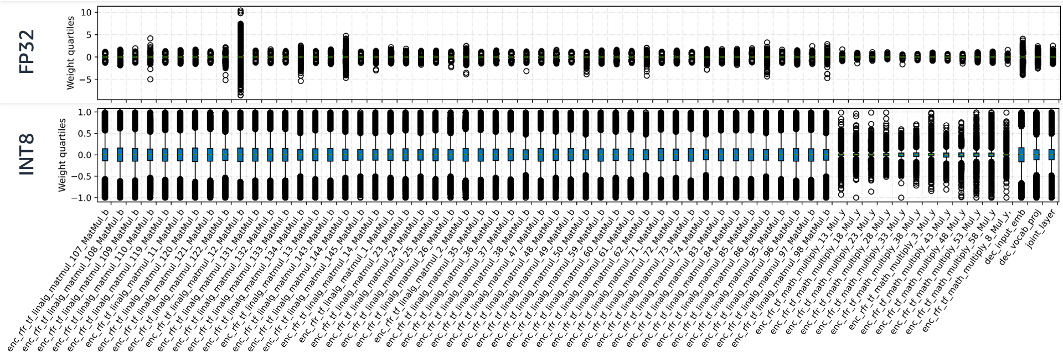
8-bit Quantization for Cloud Conformer on CPU
8-bit post-training quantization can be lossy
32-bit trained weight distributions vary among layers

Slide 15
8-bit Quantization for Cloud Conformer on CPU
8-bit post-training quantization can be lossy
How much accuracy loss exactly is from 8-bit PTQ?
FP32
FP32
FP32
FP32
INT8
Conformer training in Phasa
Serialization in Phasa
IL in Phasa
EB in Phasa
Packaging
In DBS
FP32
Packaging
In DBS
Test set | INT8 | FP32 | WERR (FP32 v.s. INT8)
tail_golden_live | 4.93 | 4.7 | 5
wbr | 7.69 | 7.63 | 1
system_multiturn_2022 | 10.22 | 10.15 | 1
https://blueflame-eu.aka.amazon.com/execution/00ae93c7-5b14-45bd-8fd4-b1ab5f690d56

Slide 16
8-bit Quantization for Cloud Conformer on CPU
QAT+PTQ v.s. PTQ
With QAT, the de-DE Conformer candidate shows 2-4% WERR after NB on wbr/tail/multiturn.
Disabling both LM passes, we still observe 1-2% WERR.
Test set | FP32->INT8 | ~FP8->INT8 | WERR
tail_selection | 7.41 | 7.18 | 3
wbr | 7.72 | 7.51 | 3
system_multiturn | 10.41 | 10.01 | 4
Test set | FP32->INT8 | ~FP8->INT8 | WERR
tail_selection | 7.56 | 7.5 | 1
wbr | 7.83 | 7.75 | 1
system_multiturn | 10.73 | 10.55 | 2
INT8
INT8
INT8
Packaging
In DBS
Packaging
In DBS
Packaging
In DBS
✓
✓
✓
FP8
~FP8
~FP8
~FP8
INT8
Conformer training in Phasa
Serialization in Phasa
IL in Phasa
EB in Phasa
Packaging
In DBS
✓
https://blueflame-eu.aka.amazon.com/execution/96c616a0-2a55-4cae-bdc8-d4b829b4d068
(LM disabled) https://blueflame-eu.aka.amazon.com/execution/3cbde29c-9c37-4607-8e61-a6bc93f5a312

Slide 17
Neural Efficiency via Software-Hardware Co-Design
Model optimization needs to be hardware specific.
Compression Type
Hardware Type
Model Type
Product Impact
(Sub-)8-bit quantization
NNA
(L)AM
Bluebottle, Crosstown
8-bit
quantization
CPU
Cloud ASR
2:4 sparsity
GPU
RescoreBERT
Cloud ASR (Let’s Chat)

Slide 18
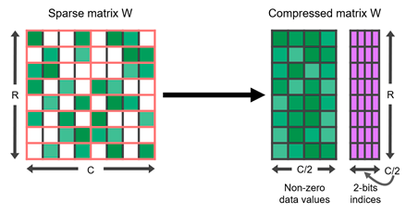


2:4 Sparsity on GPU
Put val
at pos <01>
Put val
at pos <11>

Slide 19
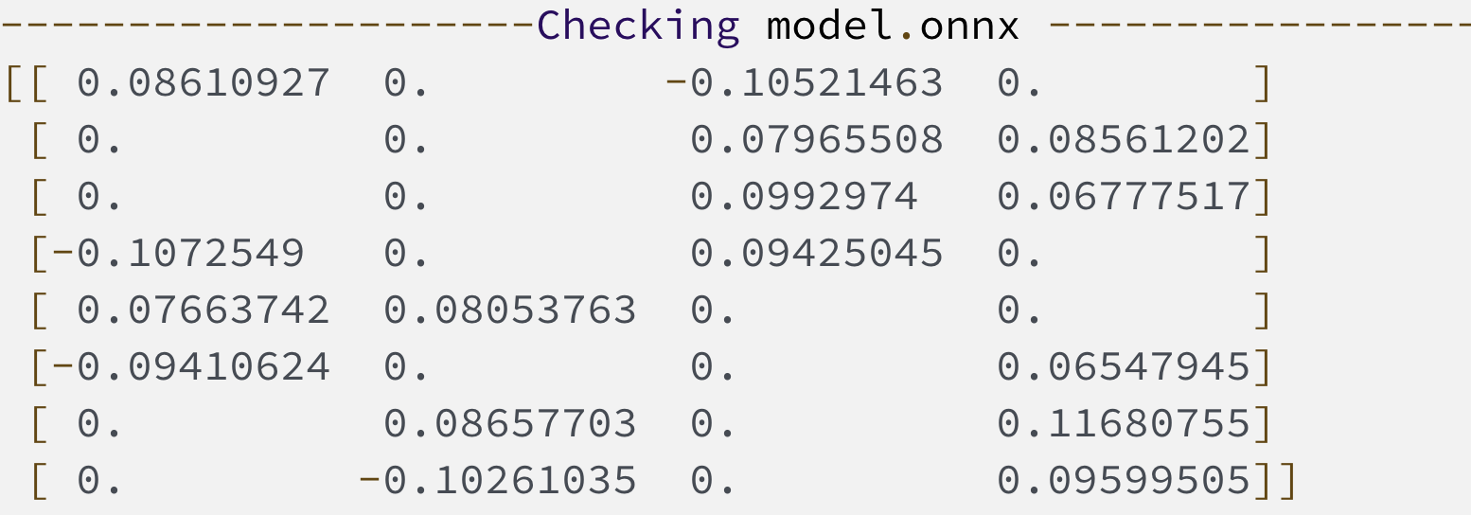
2:4 Sparse RescoreBERT
Hosted on g5
Sparse Tensor Cores accelerate a 2:4 sparsity pattern on NVIDIA A100 GPU
Low metadata overhead
Up to 2x runtime speedup
Input Operands | Accumulator | Dense TOPS | Sparse TOPS
FP32 | FP32 | 19.5 | –
TF32 | FP32 | 156 | 312
FP16 | FP32 | 312 | 624
BF16 | FP32 | 312 | 624
FP16 | FP16 | 312 | 624
INT8 | INT32 | 624 | 1248
https://hanlab.mit.edu/files/course/slides/MIT-TinyML-Lec04-Pruning-II.pdf
https://developer.nvidia.com/blog/accelerating-inference-with-sparsity-using-ampere-and-tensorrt/

Slide 20
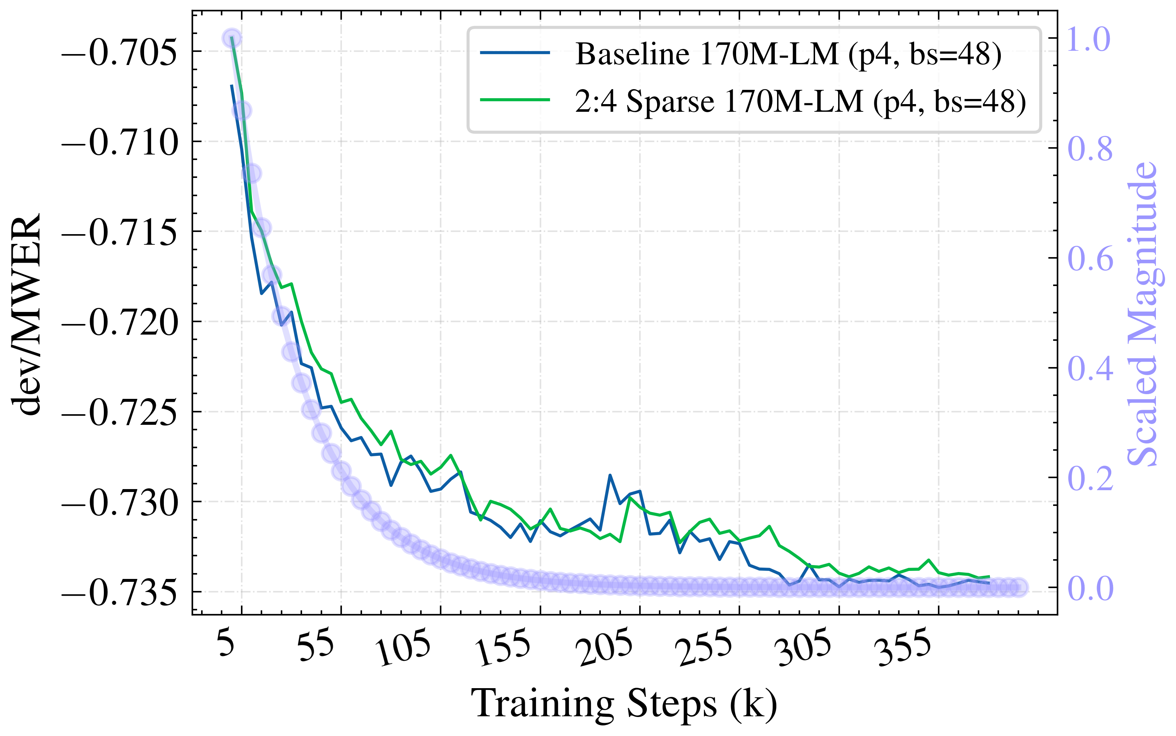
2:4 Sparse RescoreBERT
Accuracy
No degradation observed during training
In Bluebottle, w. sparse RescoreBERT
No degradation on glidepath
1% relative degradation on tail
Test set | Dense LM | Sparse LM | Rel. Deg.
glidepath | 8.39 | 8.41 | 0
Info_tail | 6.51 | 6.56 | 1
170M RescoreBERT | dev/WER | dev/MWER | dev/untuned_wer
Baseline | 0.13 | -0.73 | 11.61
50% sparsity | 0.13 | -0.73 | 11.62
glidepath: https://blueflame-na.aka.amazon.com/execution/3d9393a2-b687-4602-a427-487af4c88801
tail: https://blueflame-na.aka.amazon.com/execution/73f16167-cc7e-4cd4-aae6-3874bfb3a01f

Slide 21
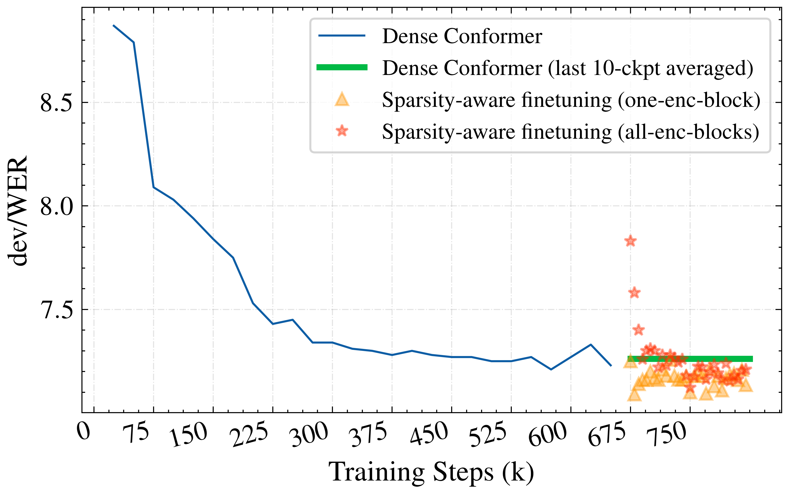
2:4 Sparse Conformer
Sparsity-aware finetuning
Pruning one encoding block (yellow triangle mark) does not degrade dev/WER noticeably.
All-encoder pruning is lossy yet recoverable within ~5 epochs (red star marks gradually approach the green line).
~1-week
~1-day
glidepath: https://blueflame-na.aka.amazon.com/execution/3d9393a2-b687-4602-a427-487af4c88801
tail: https://blueflame-na.aka.amazon.com/execution/73f16167-cc7e-4cd4-aae6-3874bfb3a01f

Slide 22
2:4 Sparsity
What’s next?
Runtime support for sparse RescoreBERT/Conformer acceleration
https://sim.amazon.com/issues/ASRCT-3927 (RescoreBERT)
https://sim.amazon.com/issues/ASRCT-3948 (Conformer)
Depends on the readiness of TensorRT-9
Accuracy verification in Let’s Chat package
2:4 sparsity for large Conformer
P4 shortage

Slide 23
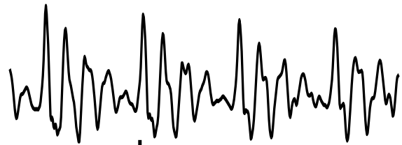
CTC Decoder
Conformer Encoder
Conformer Encoder
Conformer Encoder

Slide 24
CTC Decoder
Conformer Encoder
Conformer Encoder
Conformer Encoder
Conformer
Encoder

Slide 25
CTC Decoder
CTC Decoder
CTC Decoder
Conformer Encoder
Conformer Encoder
Conformer
Encoder

Slide 26
hypothesis-2
CTC Decoder
hypothesis-1
hypothesis-n
CTC Decoder
CTC Decoder
Conformer Encoder
Conformer Encoder
BERT
Conformer
Encoder
hypothesis-best

